Slide 1


Walker Basin
Spring Flood Outlook
tim.bardsley@noaa.gov
chris.smallcomb@noaa.gov
4.7.17
Reno National Weather Service
Forecasting for the Sierra and western Nevada since 1905
1

Slide 2
Key Points Up Front
Flooding virtually certain spring into summer along rivers and streams fed by
snowmelt. The question is how bad?
Flood severity will ultimately depend on spring storms, temperatures.
Additions to snowpack like this weekend and lowering albedo delay melt till
greater solar energy is available.
Flash flooding - remains high risk through spring, even from just moderate storms due to soil wetness.
Thru Mid April: Active weather continues and cooler temps.
Week system
Tuesday, potentially more significant system late next week.
Reno National Weather Service
Forecasting for the Sierra and western Nevada since 1905
2

Slide 3
Where Are We At Now?

Slide 4
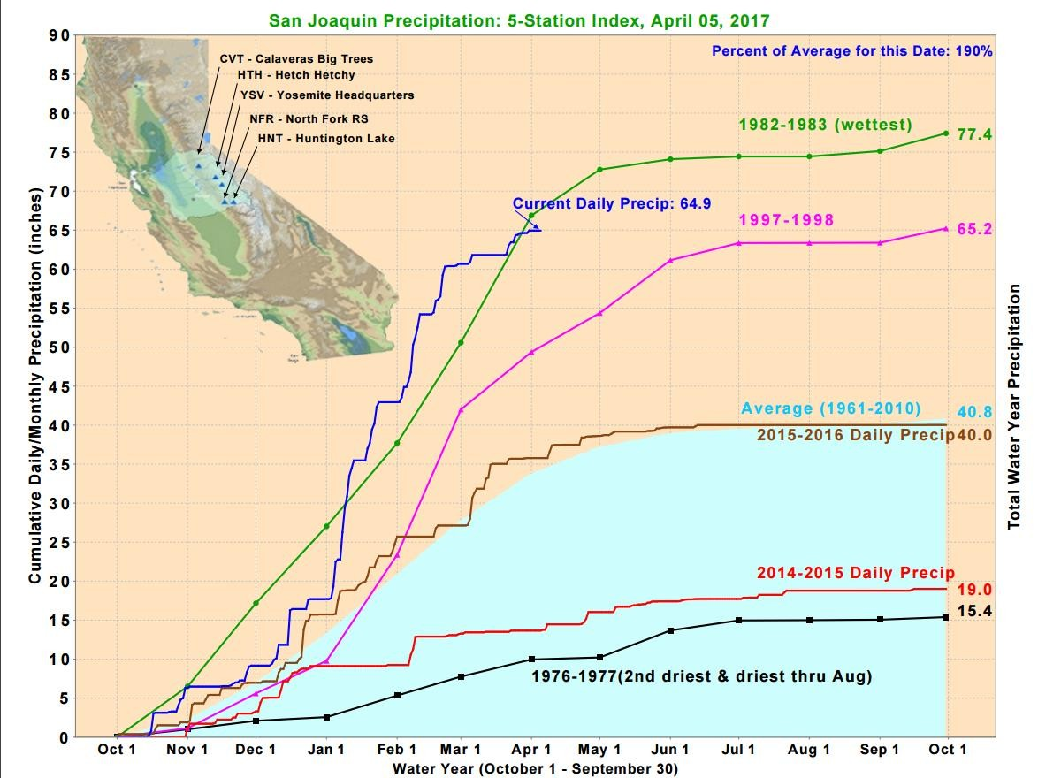
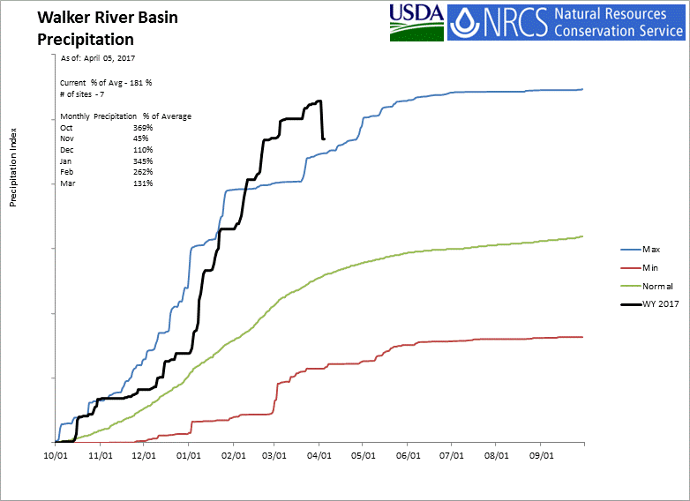
Big
Winter
with
Few
Pauses
~206
Reno National Weather Service
Forecasting for the Sierra and western Nevada since 1905
4

Slide 5
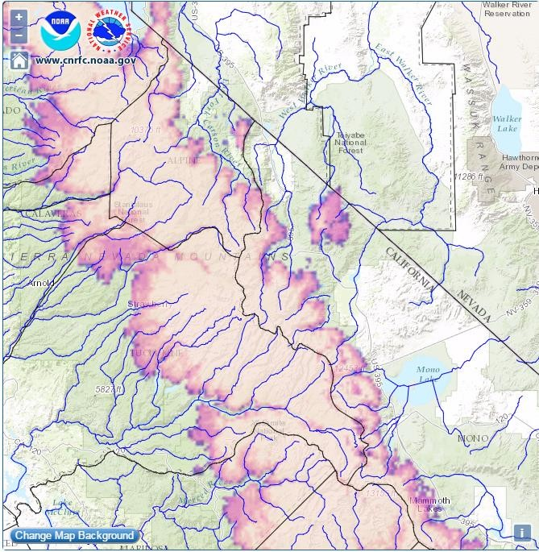
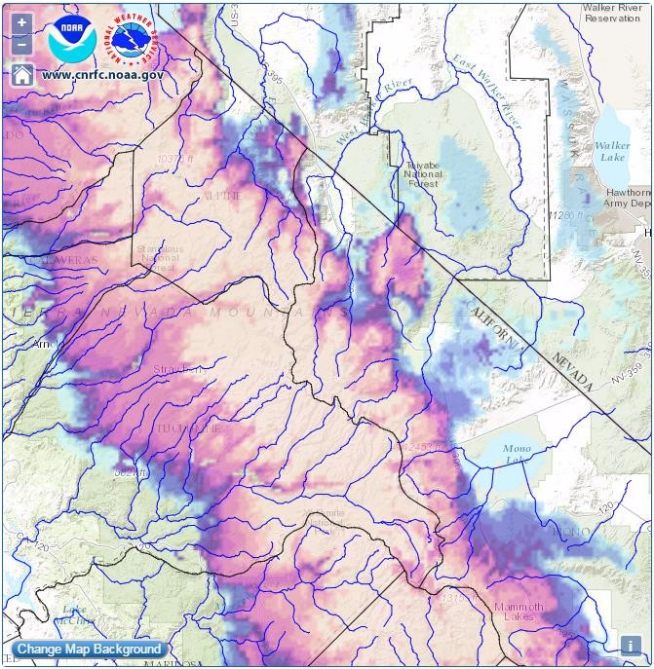
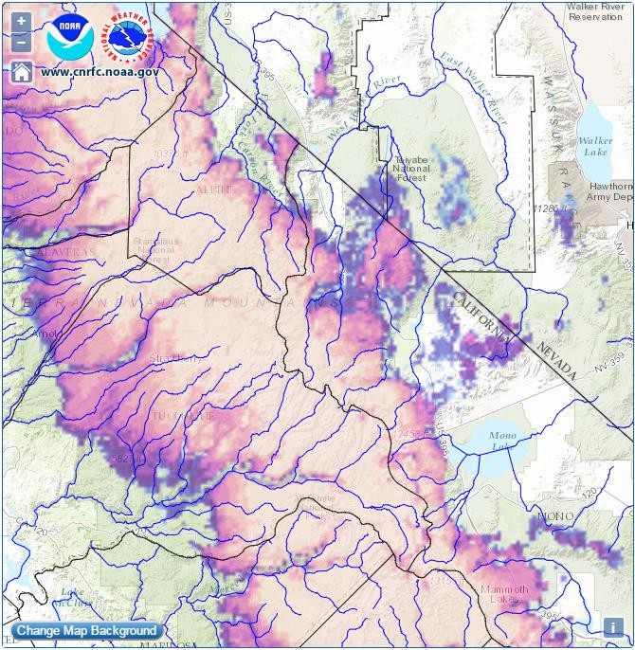

Comparing
2017
Snowpack
to
Other
Years
on
4/1
2016
4/6/2017
4/6/2006
4/6/2011
Reno National Weather Service
Forecasting for the Sierra and western Nevada since 1905
5

Slide 6
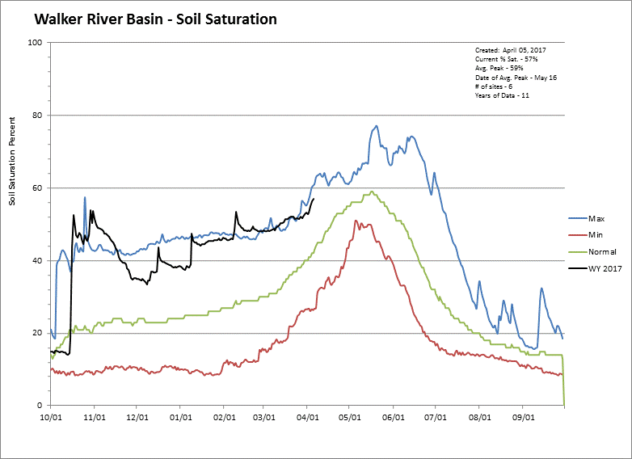
Soils
Remain
Very
Damp
Reno National Weather Service
Forecasting for the Sierra and western Nevada since 1905
6

Slide 7
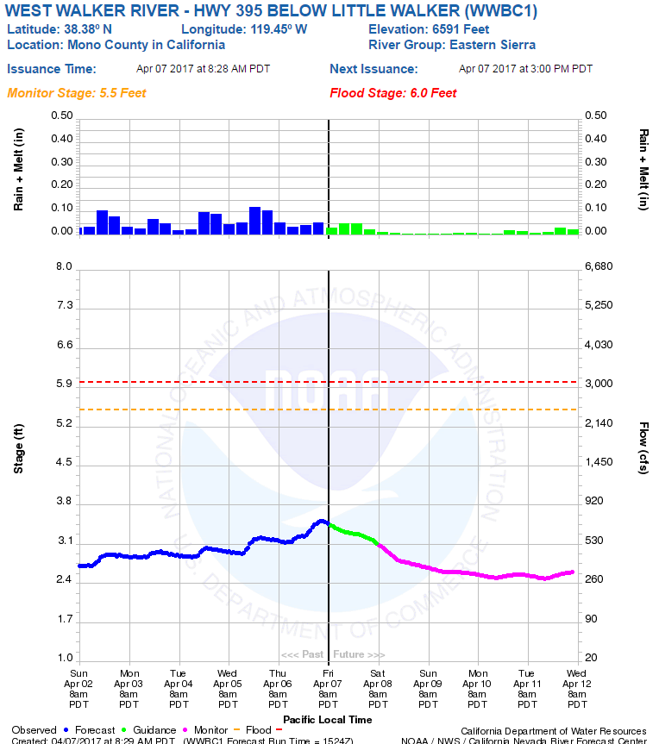
River
Simulations
Pearls of Wisdom
● Moderate rises from
overnight rain
● Recession then
return to diurnal snowmelt early in the week.
Reno National Weather Service
Forecasting for the Sierra and western Nevada since 1905
7

Slide 8
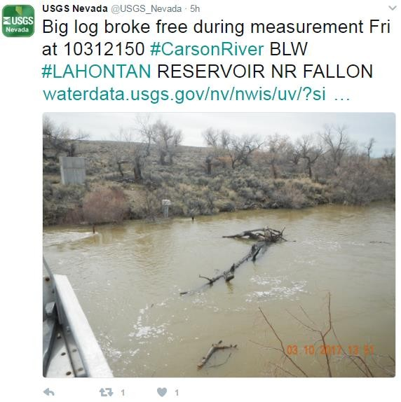
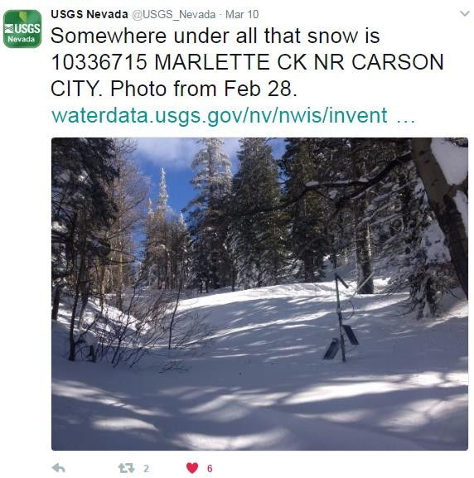
Water Supply and
Snowmelt Flood
Projections

Slide 9
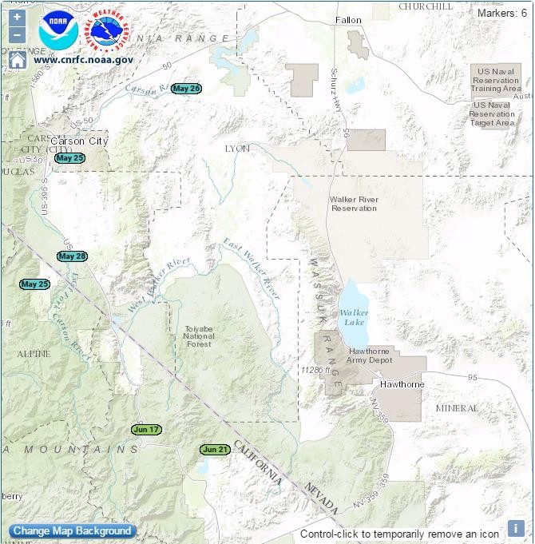
Most
Likely
Peak
Flow
Dates
Peak dates tend to be delayed
during large snowpack years.
But high densities indicate warm
and ripe snowpack may allow
for earlier melt
High degree of uncertainty this far
out. Much will depend on
spring weather and additional
snowpack accumulation.
Reno National Weather Service
Forecasting for the Sierra and western Nevada since 1905
9

Slide 10
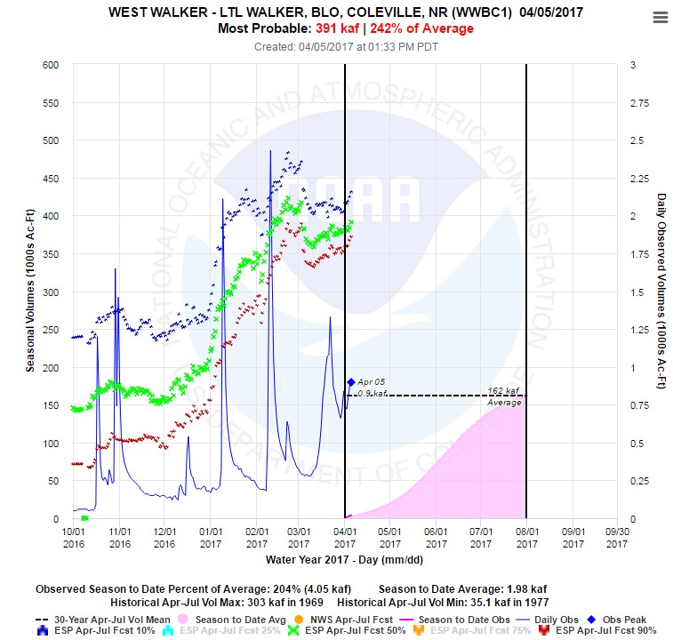
What
Does
this
Mean
for
the
Walker
River?
April-July runoff
projections have
dropped some in early
March with mild
weather , but
rebounding with active
early April.
Reno National Weather Service
Forecasting for the Sierra and western Nevada since 1905
10

Slide 11
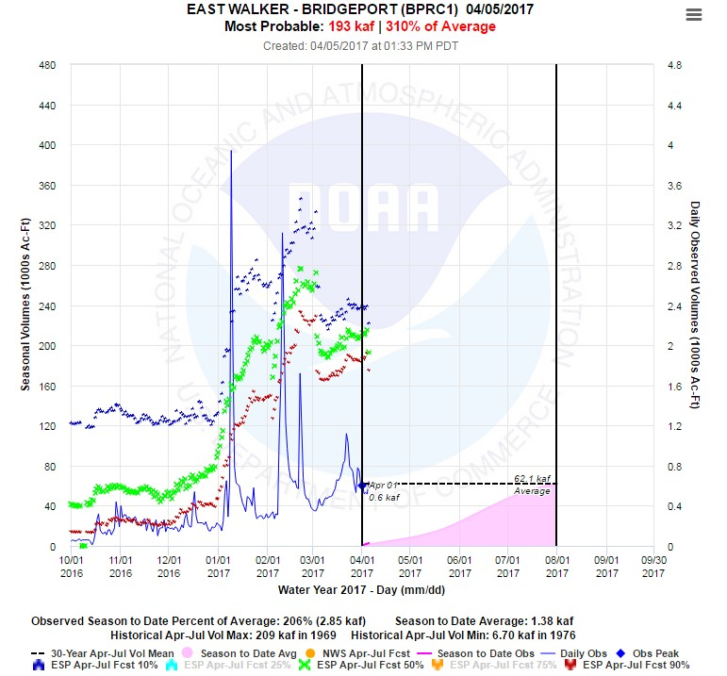
What
Does
this
Mean
for
the
Walker
River?
April-July runoff
projections have
dropped some in early
March with mild
weather , but
rebounding with active
early April.
Reno National Weather Service
Forecasting for the Sierra and western Nevada since 1905
11

Slide 12
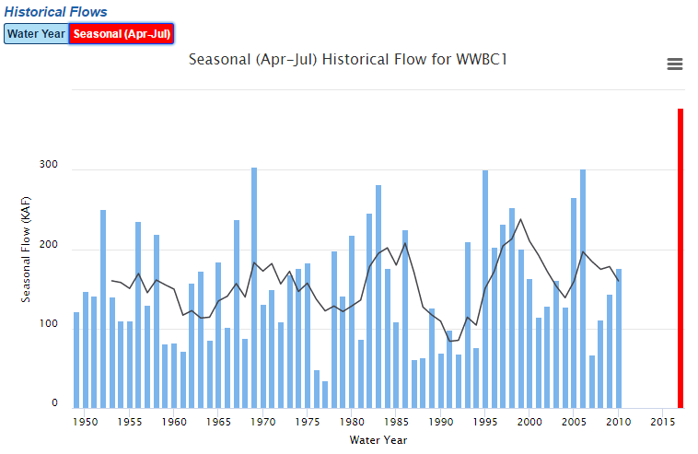
Reno National Weather Service
12
Forecasting for the Sierra and western Nevada since 1905

Slide 13
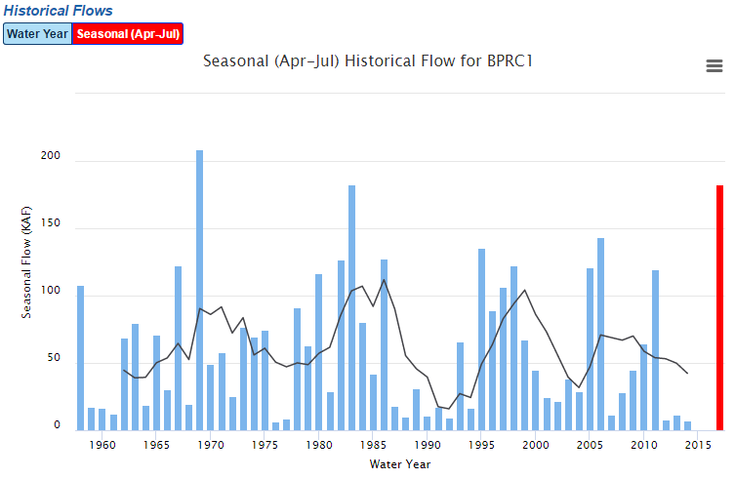
Reno National Weather Service
13
Forecasting for the Sierra and western Nevada since 1905

Slide 14
Snow-melt Best vs Worst Case Scenarios
Best Case - Persistent minor to at times moderate flooding April-
June. Mainly Carson, Walker, Humboldt Rivers. Result of gradual
spring warm-up, methodical snow melt from low to high
elevations, with no major storms nor heatwaves.
Worst Case - Persistent minor-moderate flooding April-June on
rivers. Several peaks to major flood for days-weeks due to AR
storms with heavy rain or heatwaves (and/or delayed melt) rapidly
melting snow. Even Truckee, Feather, Susan rivers get in on flood
action. Flash flooding in canyons, streams.
Reno National Weather Service
14
Forecasting for the Sierra and western Nevada since 1905

Slide 15
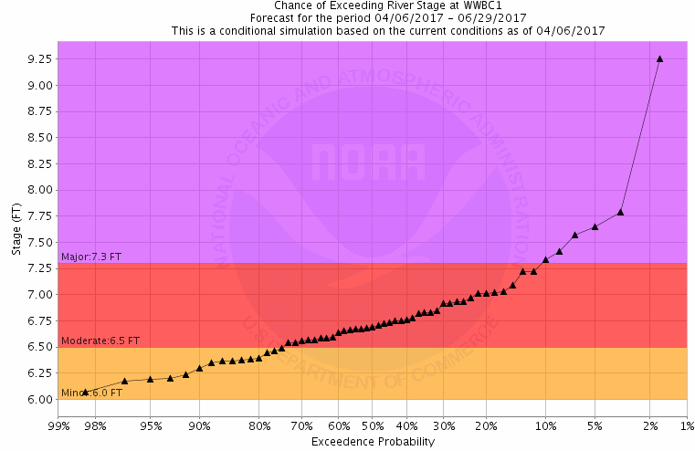
Experimental
Long
Range
Flood
Risk-
West
Walker
Similar information
available for Bridgeport inflow, via build your own feature on CNRFC page
90% ~1300 50% ~1600,
10% ~ 1900
Reno National Weather Service
Forecasting for the Sierra and western Nevada since 1905
15

Slide 16
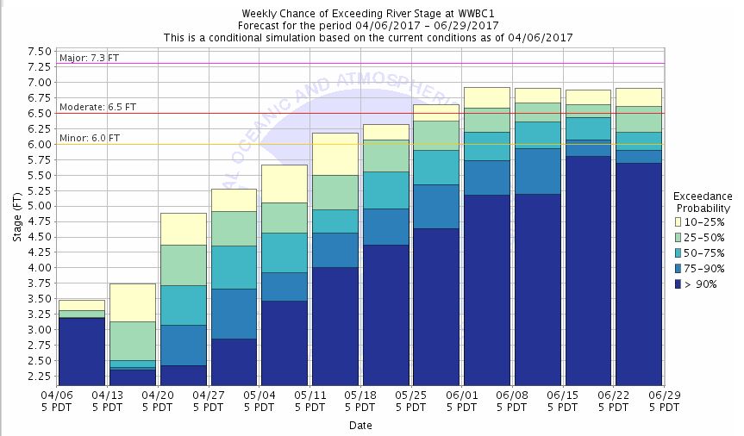
Experimental
Long
Range
Flood
Risk-
West
Walker
Reno National Weather Service
Forecasting for the Sierra and western Nevada since 1905
16

Slide 17
Long-Range Freak Out Scale
Chris & Tim’s Rough Sketch on Timing the Highest Risks of Snowmelt Flooding
March
April
May
June
July
August
Walker River Basin
Carson River Basin
Truckee River Basin
Tahoe Basin
Creeks/Streams
NE California Basins
E Sierra Creeks/Streams
Humboldt River Basin
What Does This Mean?
No worries
Low level of freakoutness
Moderate freakoutness
High freakoutness
End of this
Reno National Weather Service
Forecasting for the Sierra and western Nevada since 1905
17

Slide 18
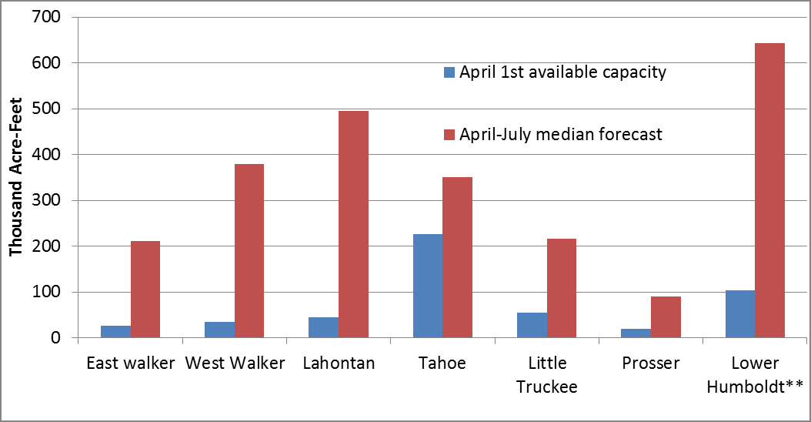
Reservoir
Space
vs
What’s
Coming...
Reservoirs - will help reduce flooding downstream, but due to expected runoff volume
and reservoir capacities, they will not eliminate downstream flood risk.
Reno National Weather Service
18
Forecasting for the Sierra and western Nevada since 1905

Slide 19
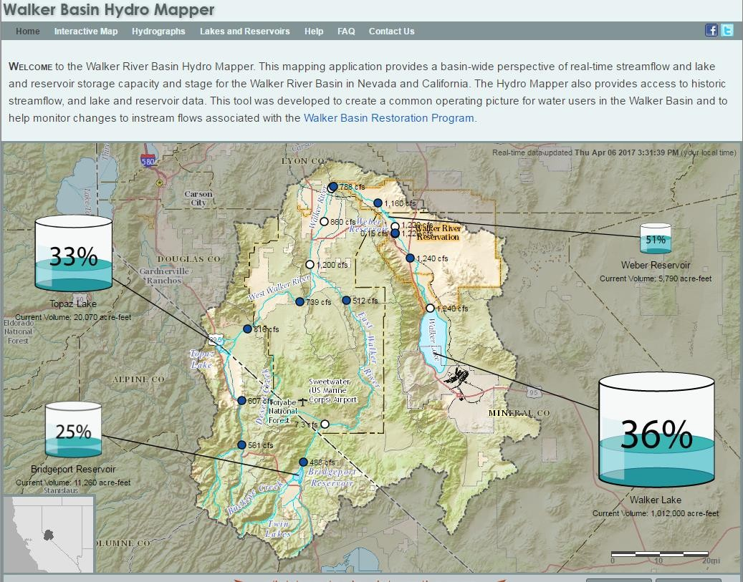
https://nevada.usgs.gov/walkerbasinhydromapper/
Reno National Weather Service
19
webapp/home.html
Forecasting for the Sierra and western Nevada since 1905

Slide 20

Weather Briefing
What’s expected today...
Second wave still on track This Evening - Sat Morning: Colder with broader snow
impacts to mountain towns and passes, W Nevada foothills/VC. Snow and pellet
showers continuing into Sat PM areawide. Less flash flood risk but not zero,
especially prone spots. Rivers rise from earlier rain/melt lasting into weekend.
Winds remain enhanced but probably not as bad as Friday.
Look Ahead: More storms likely next week, but big questions on timing, intensity.
Latest simulations favor weak/fragmented storm Tuesday; stronger storm
Thursday or Friday. Too soon to call on snow vs flood hazards.
Reno National Weather Service
Forecasting for the Sierra and western Nevada since 1905
20
20

Slide 21

Situational Awareness - When Should I Freakout?
Chris’ 7-Day Regional Freakout Forecast for the Sierra and western Nevada
Today
Saturday
Sunday
Monday
Tuesday
Wednesday
Next Thur-Fri
Wind
widespread strong SW wind, localized damage possible
continued gusty winds, not as strong
strong winds
possible
Snow
heavy snows pass elevations, Mammoth
another round of heavy snows mountain towns, foothills/brief valleys AM
mountain snows possible but extent too soon to call
River & Snowmelt
Flooding
Rivers and Creeks Running High
possible if storm
not looking likely
comes in warm, but
Flash Flooding (fast paced flooding of streams, poor drainage and steep terrain areas, rock slides, burn scar runoff)
Threat Waining
localized runoff continuing
possible if storm
not looking likely
comes in warm, but
Unusual Cold or Heat
generally running cooler than normal but nothing outrageous
Fire Weather
the grass is green and the ground will be wet again
Thunderstorms
isolated cells with lightning possible, pellet
showers Sat
What Does This Mean?
No worries
Low level of freakoutness
Moderate freakoutness
High freakoutness
End of this
Reno National Weather Service
Forecasting for the Sierra and western Nevada since 1905
21

Slide 22
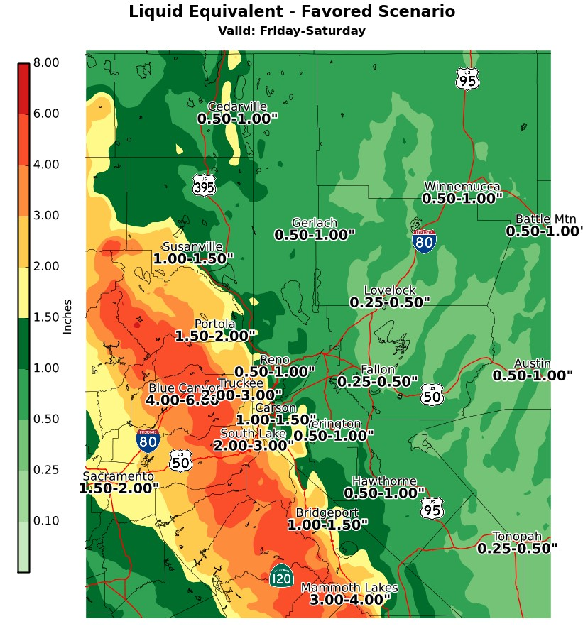

Additonal Precipitation
•
Timing - General letup in precipitation today outside of the
mountains, then another round of heavier rain/snow this evening into Sat morning. Snow levels starting 6500-7500’ today falling to 5000-6000’ tonight, then 4000-5000’ Saturday.
•
Impacts - Moderate overall impacts at this point, mainly
from snow. Travel and commute delays today due to
ponding water, low visibility. Flash flooding on streams,
creeks, and poor drainage areas during and immediately
after heavy rain periods- Threat diminishing. Areas that
have seen flooding issues this past winter could see
them again.
•
Confidence - High that we’ll see periods of heavy rain
especially below 6000’. Medium on potential flooding severity due to snow level falls this evening.
Favored scenario - 75th percentile of recent
simulations. A few show more spillover.
Reno National Weather Service
Forecasting for the Sierra and western Nevada since 1905
22

Slide 23
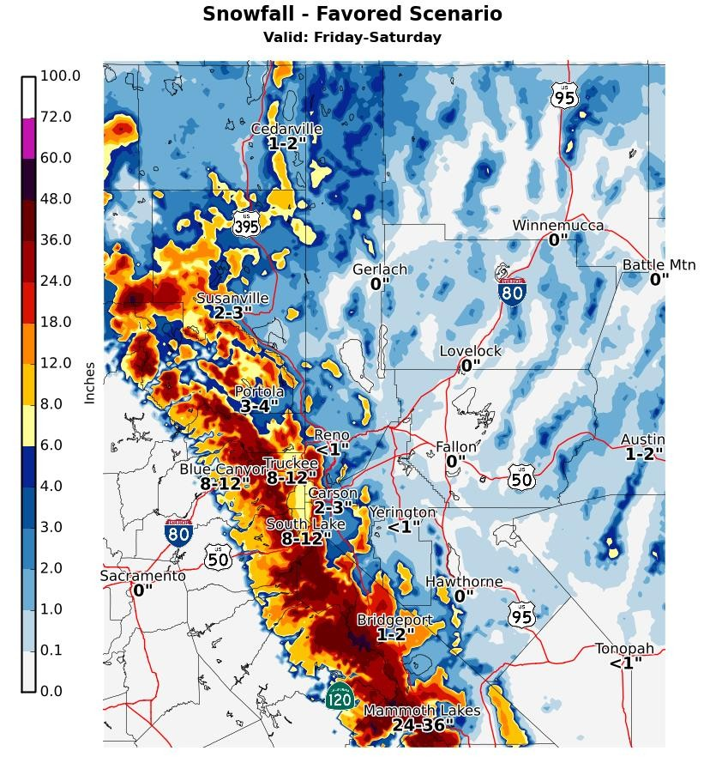

Heavy Mountain Snows
•
Timing - Snow at passes/Mammoth all day today
(SL 6500-7500’). Lowering to mountain town and foothill elevations rapidly this evening or Sat morning (SL 5000-6000’). Snow or pellet showers possible all elevations Saturday.
•
Impacts - Moderate to high-end impacts overall.
Late season storm impacting ski traffic and
commutes today - big headaches. Travel delays
due to snow, wind, low visibility over passes;
mountain, foothill communities and roads
Saturday. Wet, sloppy snow.
•
Confidence - High that we’ll see heavy snows and
travel problems above 6500’. Medium on snowfall
and impacts below 6500’ due to continued snow
level variability.
Reno National Weather Service
Forecasting for the Sierra and western Nevada since 1905
23

Slide 24
Look Ahead at
Spring Weather

Slide 25

Predictability: So When Will We Know?
Spring, summer weather : Good luck, no favored outcome
Heat waves : 5-10 days
Atmospheric rivers : 5-8 days
River flood forecasts : start 5 days out
*internal NWS simulations to 10 days
Spring heavy rains from “cutoff lows” : 1-3 days
Thunderstorm flash flood scenarios : 1-3
days ^{*general heads up}
Reno National Weather Service
Forecasting for the Sierra and western Nevada since 1905
25

Slide 26
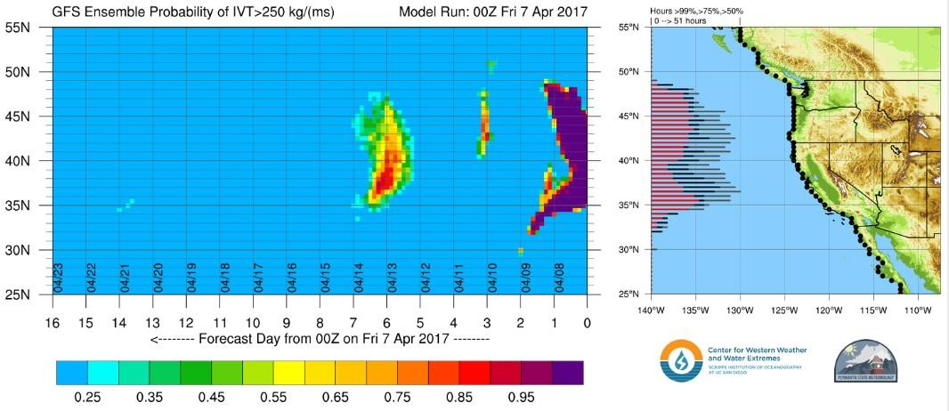

Looking
Ahead
-
16
Day
Atmospheric
River
Outlook
Chart shows the percent of simulations showing atmospheric river (AR) landfall at various
latitudes along the west coast. Time into the future goes from right to
left.
I like to look at probabilities in the
36-40 latitude bins for our region -
AR’s usually come in from SW.
Note - high probabilities do not
necessarily mean stronger AR’s.
•
•
Pattern for next week - favors additional storms, cooler than normal.
Stronger storm Thursday-Friday but snow vs flood issues too soon to call. Has the
more traditional cool spring storm, not big moist AR = leaning snow scenario.
look of a
•
These storms not good from a spring flood perspective - more snowpack + cool temperatures
to keep the snow from melting gradually.
•
26
Some hints at a quieter, warmer pattern following week but low
confidenceR.eno National Weather Service
Forecasting for the Sierra and western Nevada since 1905

Slide 27
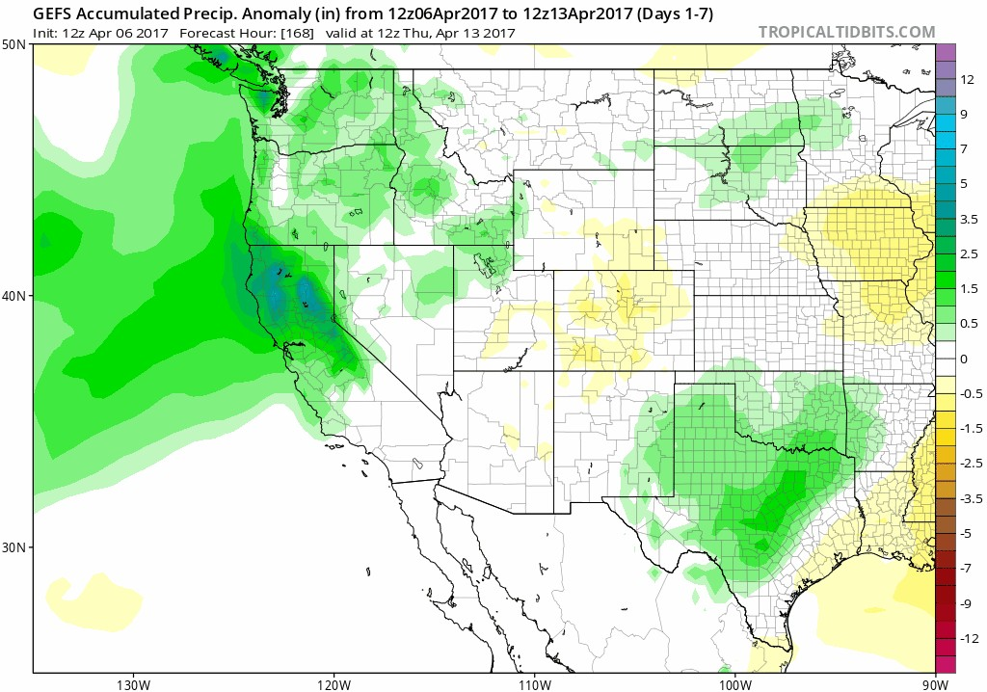

Looking
Ahead
-
16
Day
Precipitation Anomaly Outlook
Pattern favors occasional
storms through next week,
possibly longer.
Above normal precip next
week, less pronounced
signal for following week
(lower confidence)
Reno National Weather Service
Forecasting for the Sierra and western Nevada since 1905
27

Slide 28
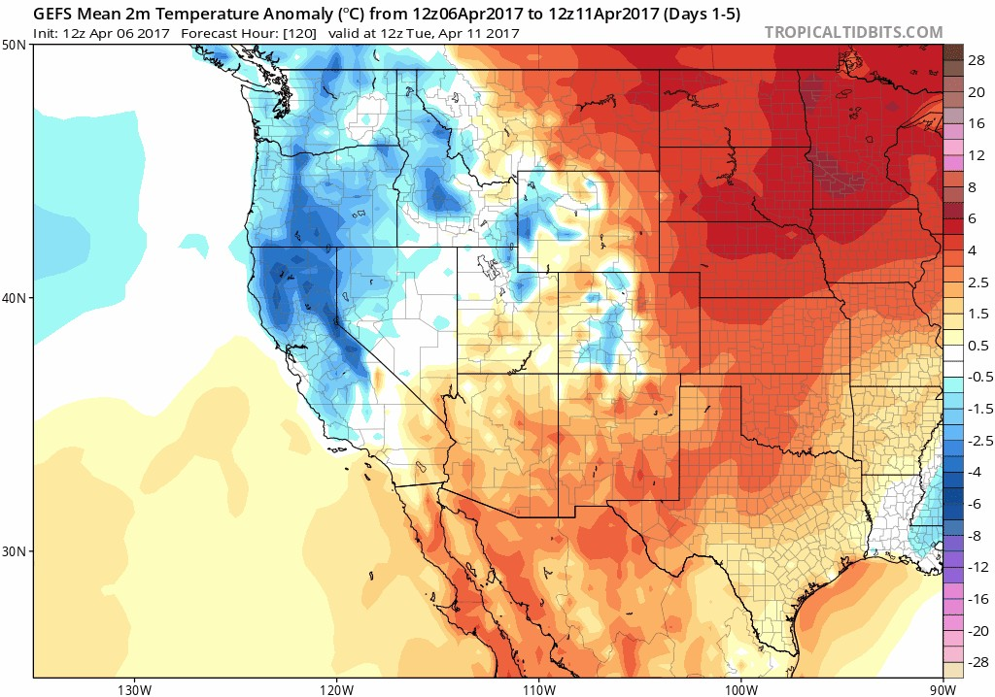

Looking
Ahead
-
16
Day
Temperature Anomaly Outlook
Pattern favors cooler than normal
temperatures through next
week.
Storms next week would likely
add to snowpack versus take
away from it.
No warming, storm blocking ridge
of high pressure - something
we’ve seen all winter long.
Possible trend toward more
seasonal temperatures late month but low confidence.
Reno National Weather Service
Forecasting for the Sierra and western Nevada since 1905
28

Slide 29
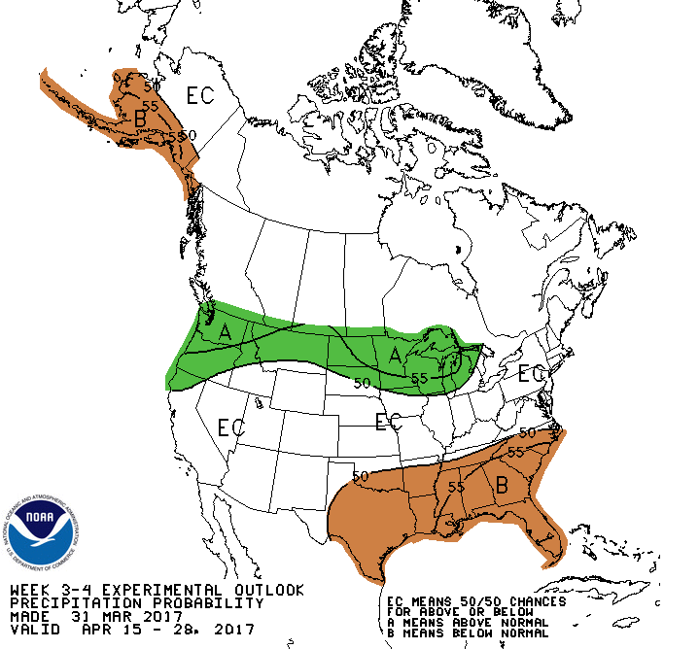
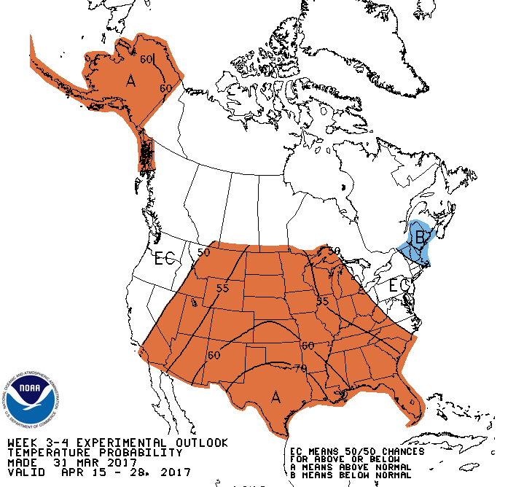

Week
3-4
Outlook
-
Second
Half
of
April
AR type storms could impact Pac NW - our
region is certainly within the margin of
error this far out so worth keeping an eye on.
No clear signal on temperatures - so could be cold vs warm.
Reno National Weather Service
29
Forecasting for the Sierra and western Nevada since 1905

Slide 30
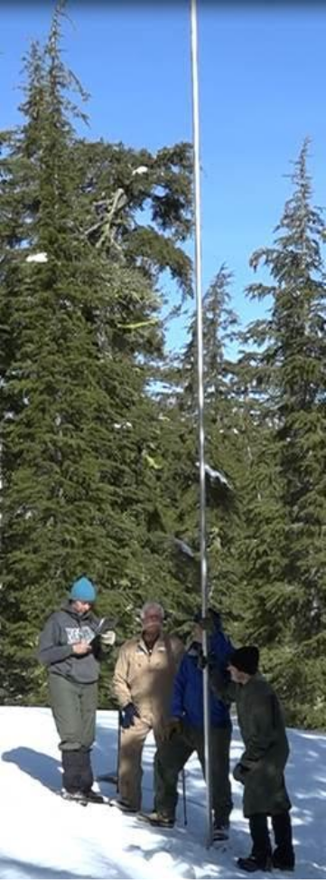
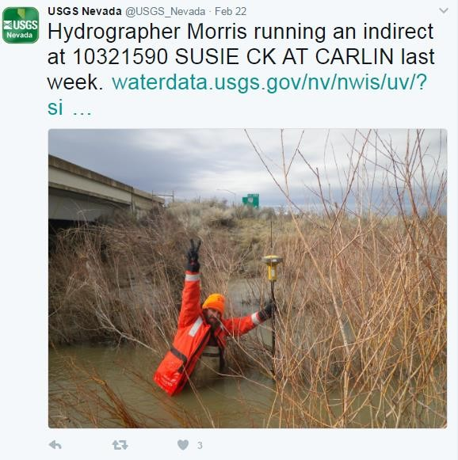
Thanks to
Photo:NRCS
a
little
help
from
our
friends...
Reno National Weather
Service
Forecasting for the Sierra and western Nevada since 1905
30

Slide 31
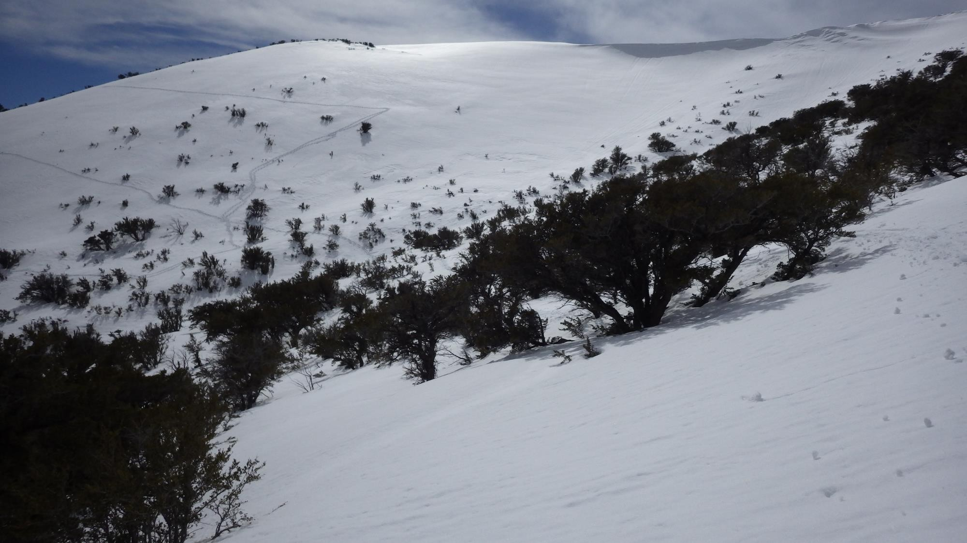
Thanks!
Tim.Bardsley@noaa.gov
Reno National Weather Service
Forecasting for the Sierra and western Nevada since 1905
31

Slide 32
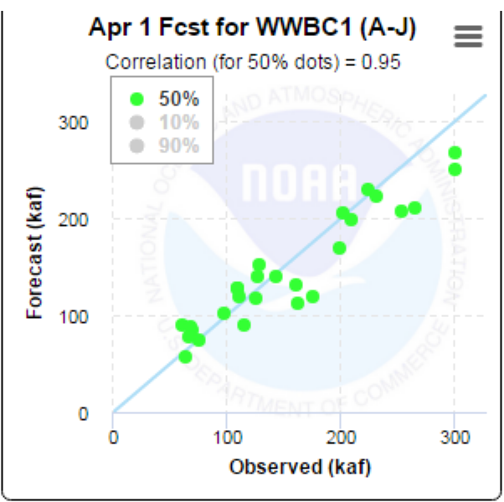
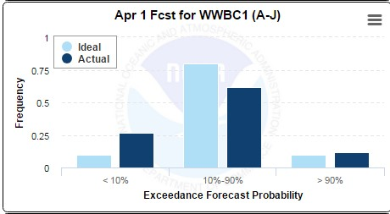
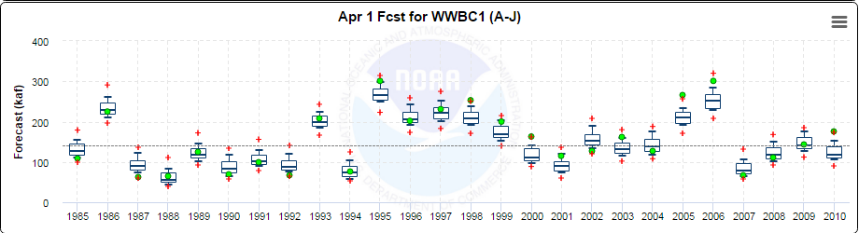
Reno National Weather Service
² Forecasting for the Sierra and western Nevada since 1905

Slide 33
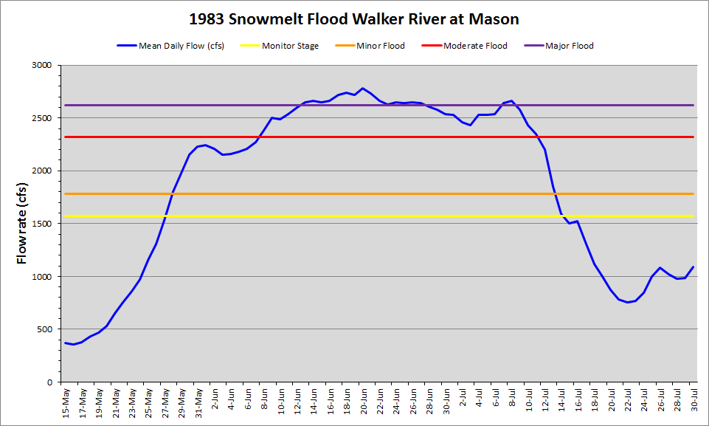
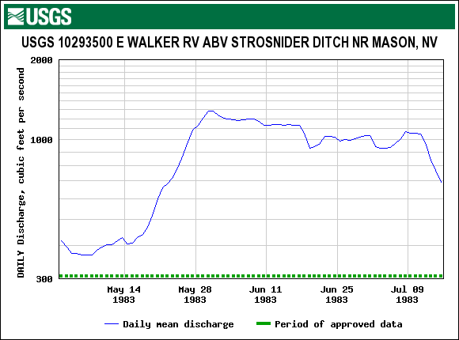
What
Does
this
Mean
for
the
Walker River?
Walker Basin is the most likely
major basin to experience
significant and prolonged
snowmelt flooding.
Minor flooding likely in upper basin,
but longer and more significant
flooding likely in valley
locations.
Iintensity based on snowmelt rate,
contributing area, and runoff
efficiency
Flooding impacts could last well
into July.
Reno National Weather Service
daily data for 1983
33
Forecasting for the Sierra and western Nevada since 1905

Slide 34
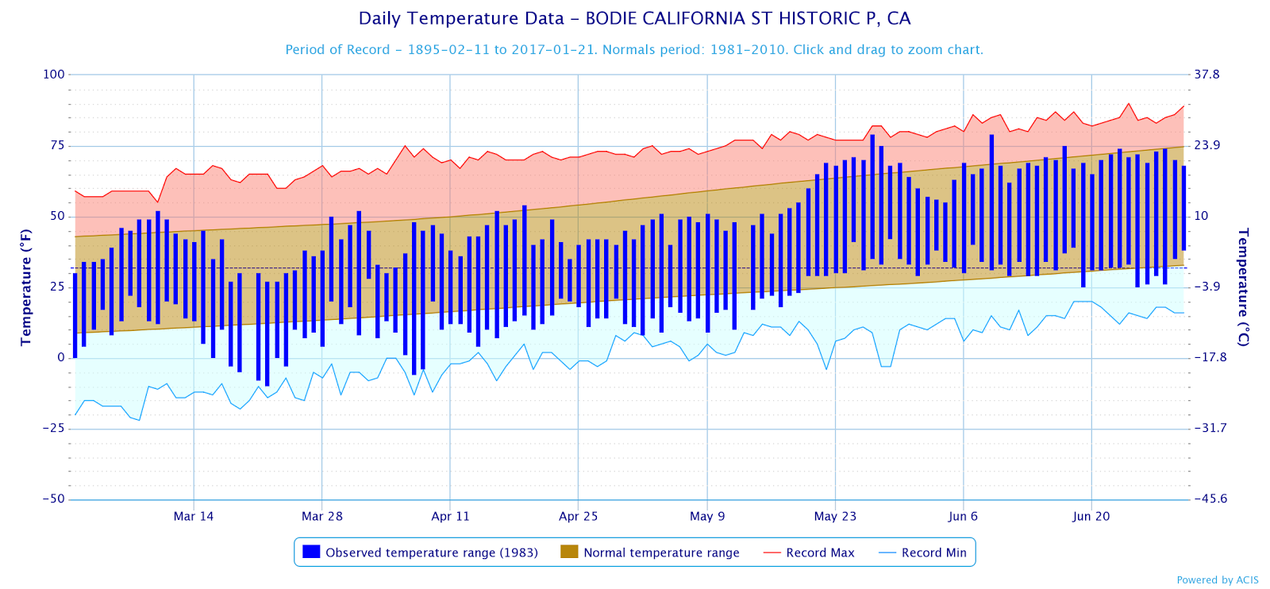
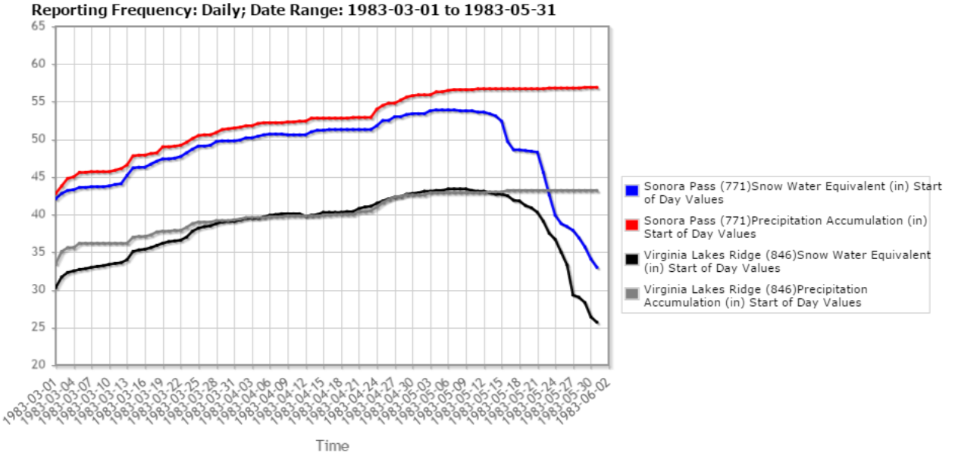
Spring
Weather
and
snowmelt
WY-
1983
Reno National Weather Service
Forecasting for the Sierra and western Nevada since 1905
34

Slide 35
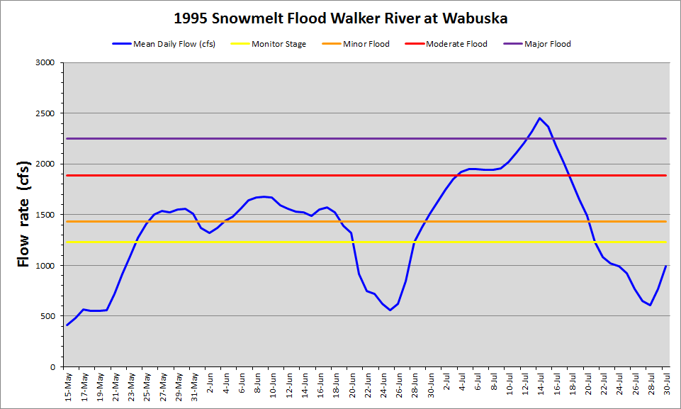
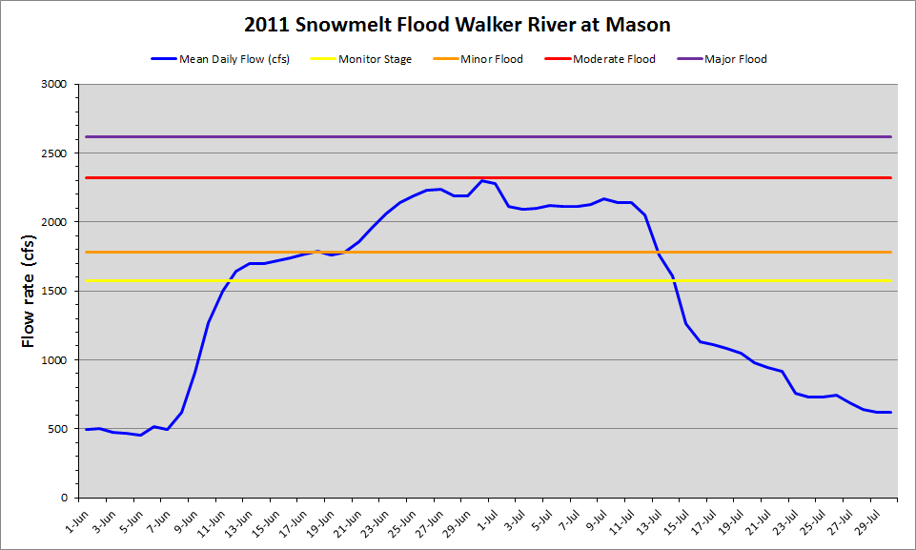
What
Does
this
Mean
for
the
Walker
River?
15 minute data for 2011
daily data for 1995
Reno National Weather Service
Forecasting for the Sierra and western Nevada since 1905
35

Slide 36
W Walker R nr Coleville Area/Elevation
Minimum Elevation 5586’, Max 11172’, 250 sq mi;
Curve
11500
10500
9500
8500
7500
6500
5500
0
10
20
30
40
50
60
70
80
90
100

